Slide 1

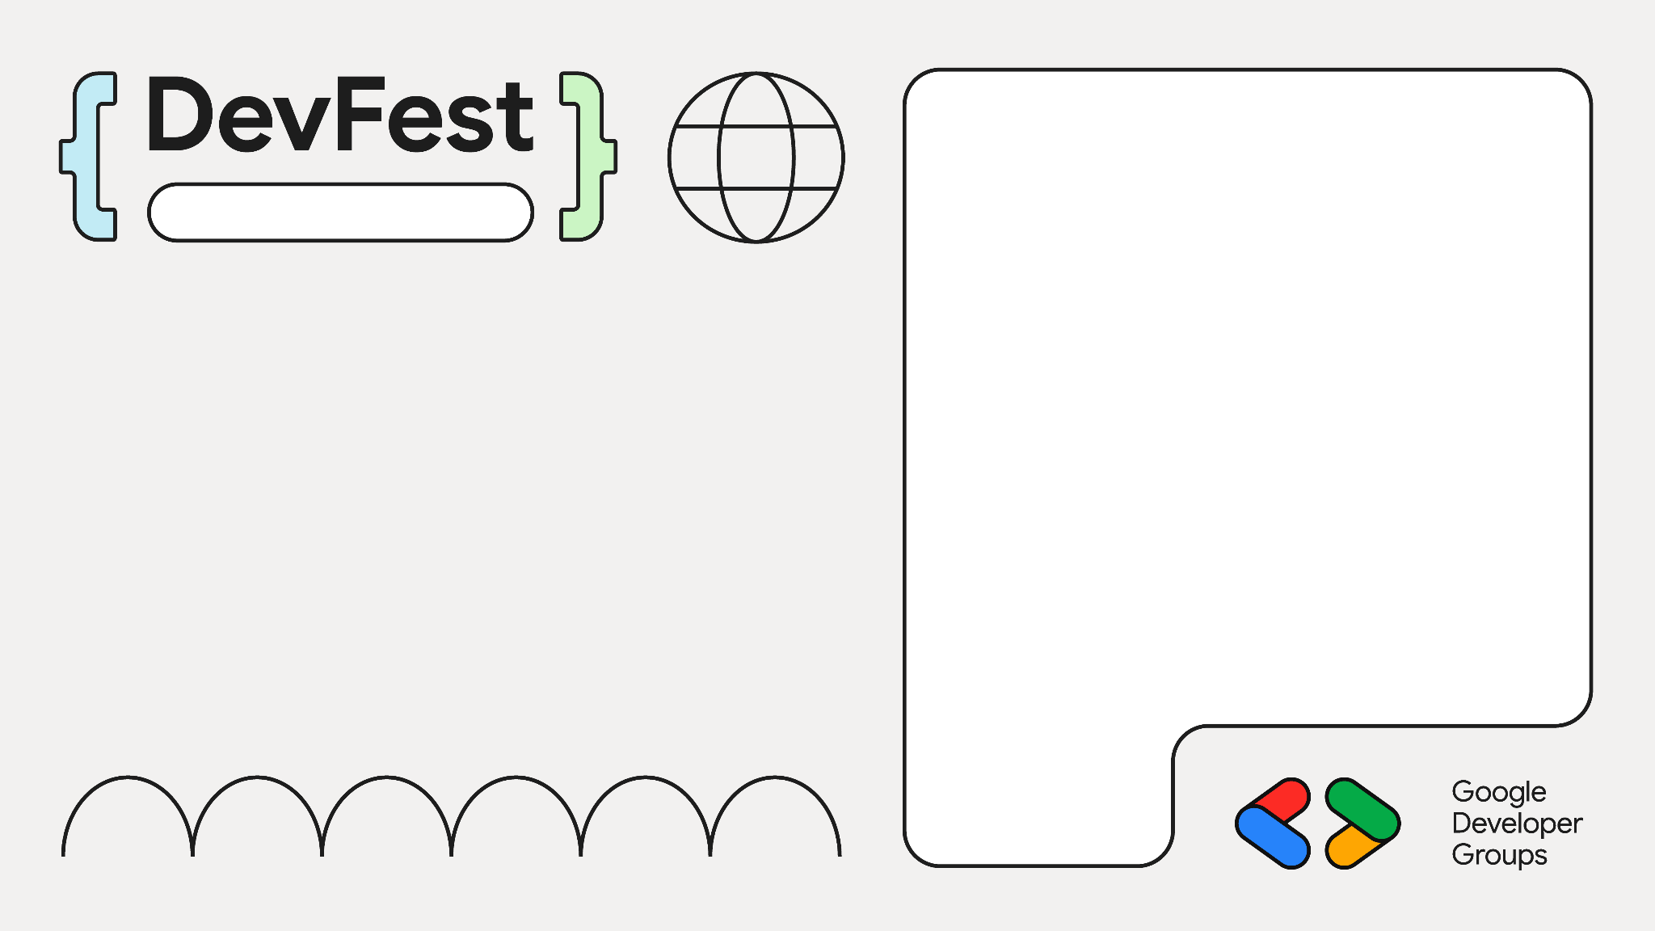
Zero to Viral:
Build TikTok-style Recommendation
Jakarta
linkedin.com/in/yodiaditya

Slide 2

How do you build short videos recommendation when all have you just raw files with no metadata and nothing else ?

Slide 3
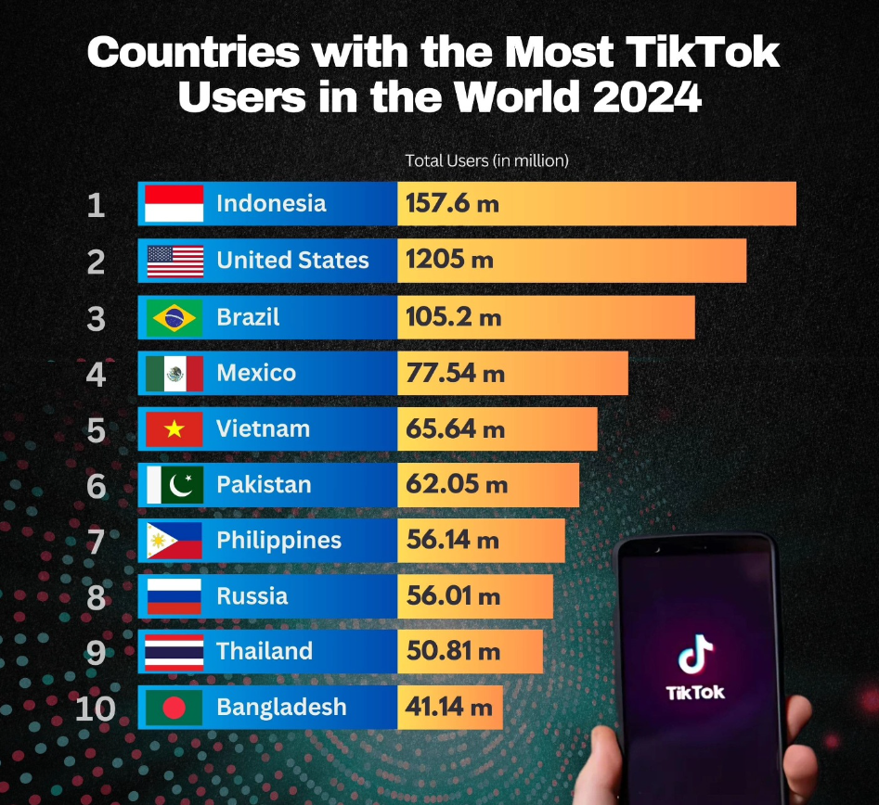
Statistics
Estimated 1 Billion views per day
34 million TikTok videos are uploaded daily

Slide 4
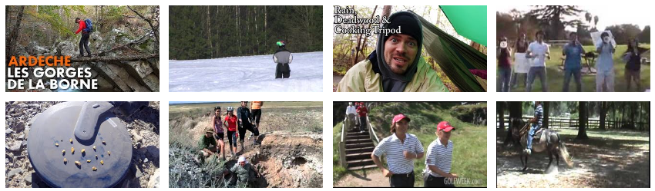
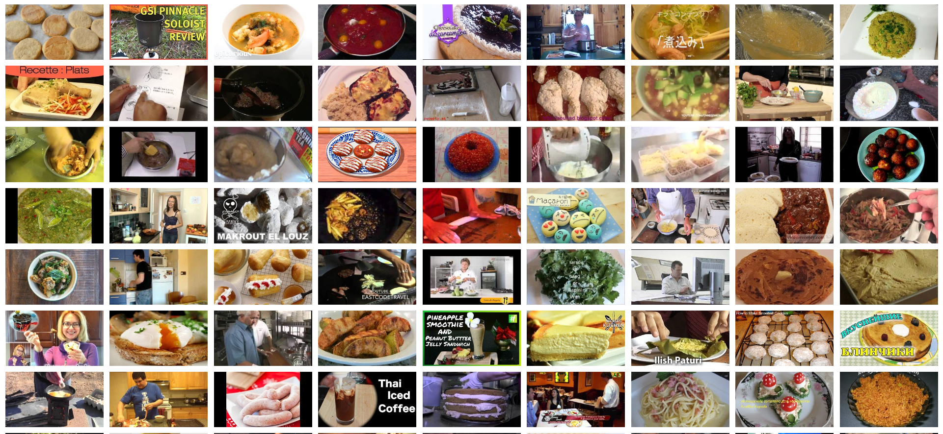
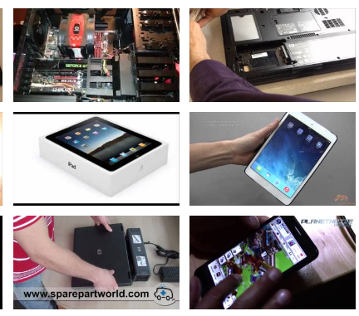
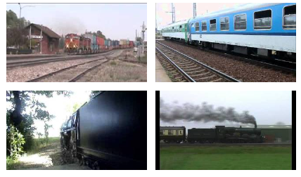
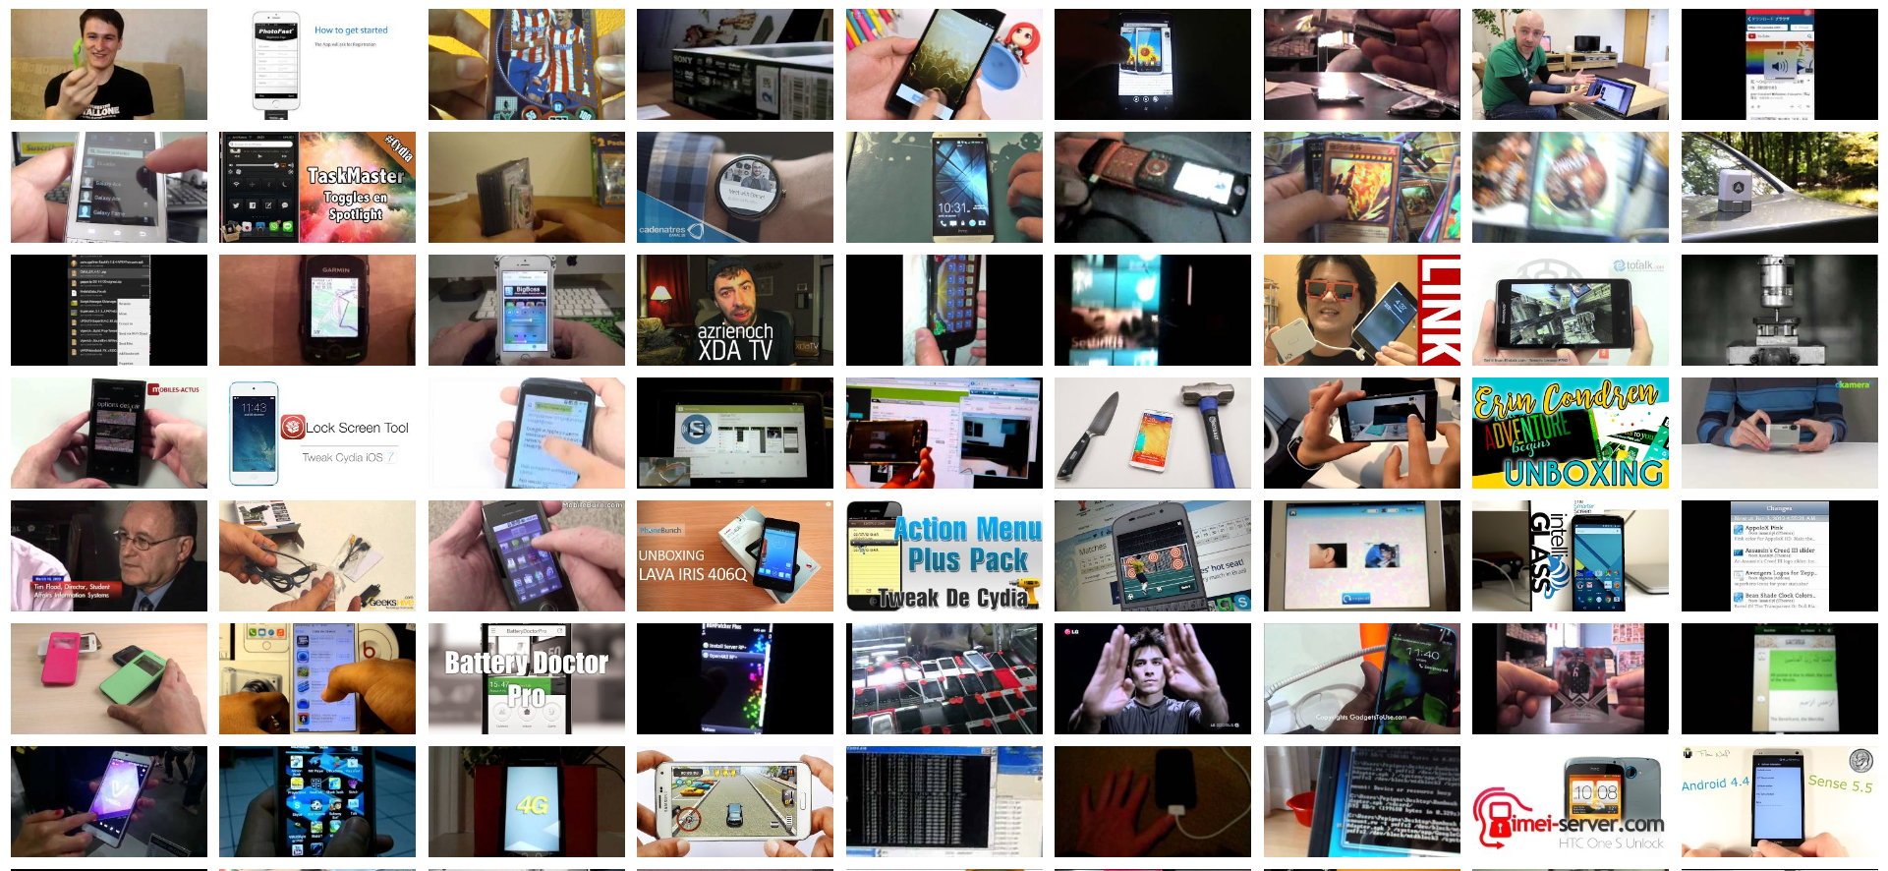
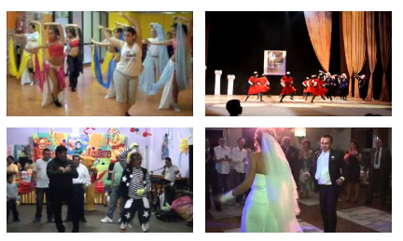
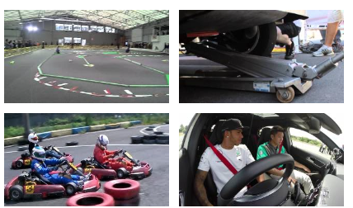
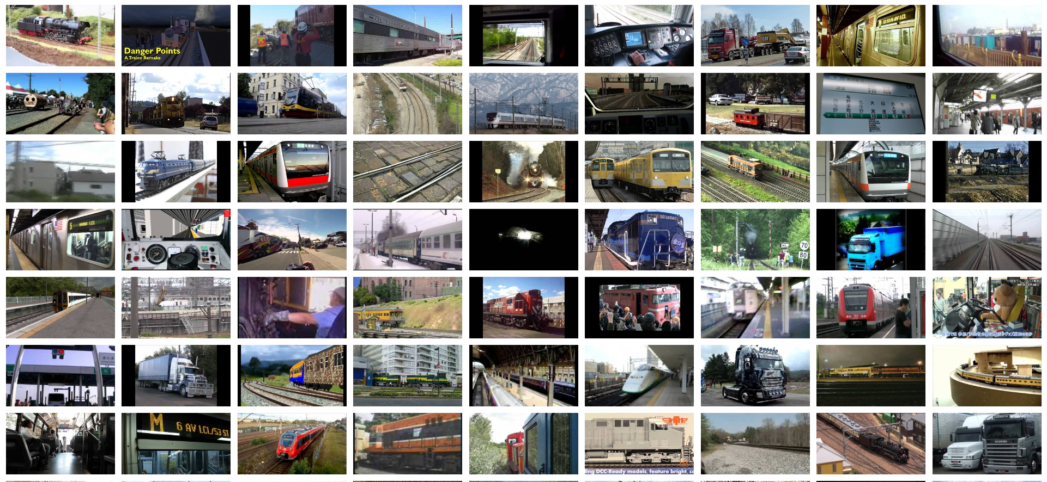
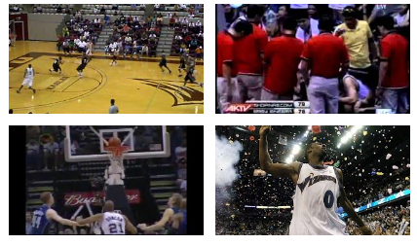
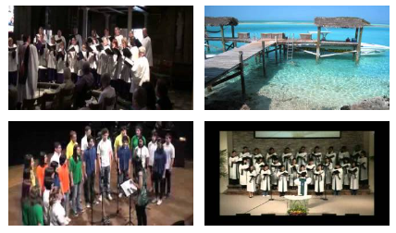
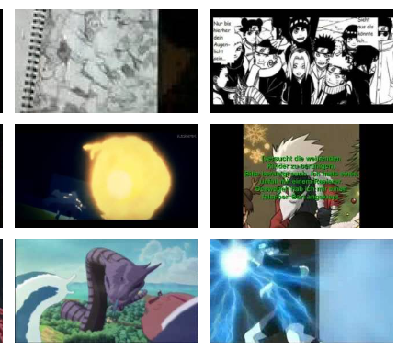
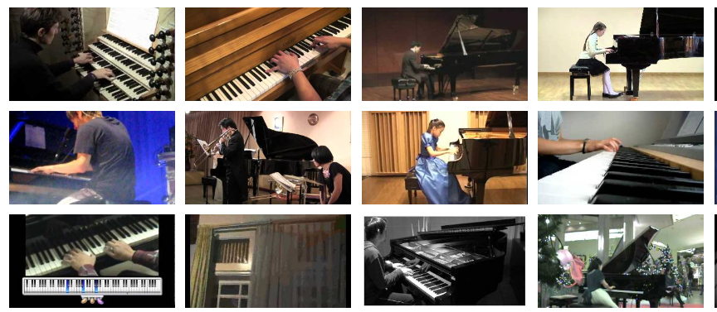
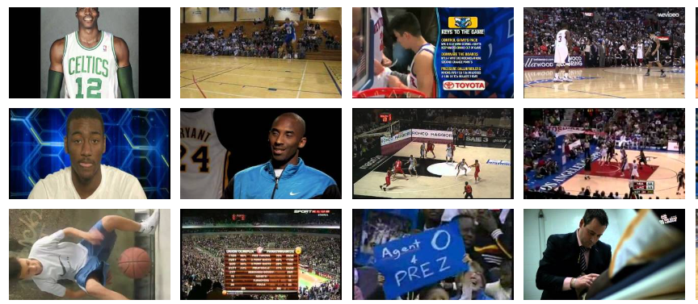
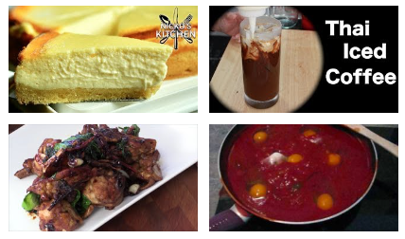
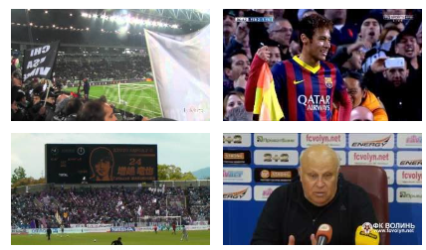
How to deal with these videos ?

Slide 5

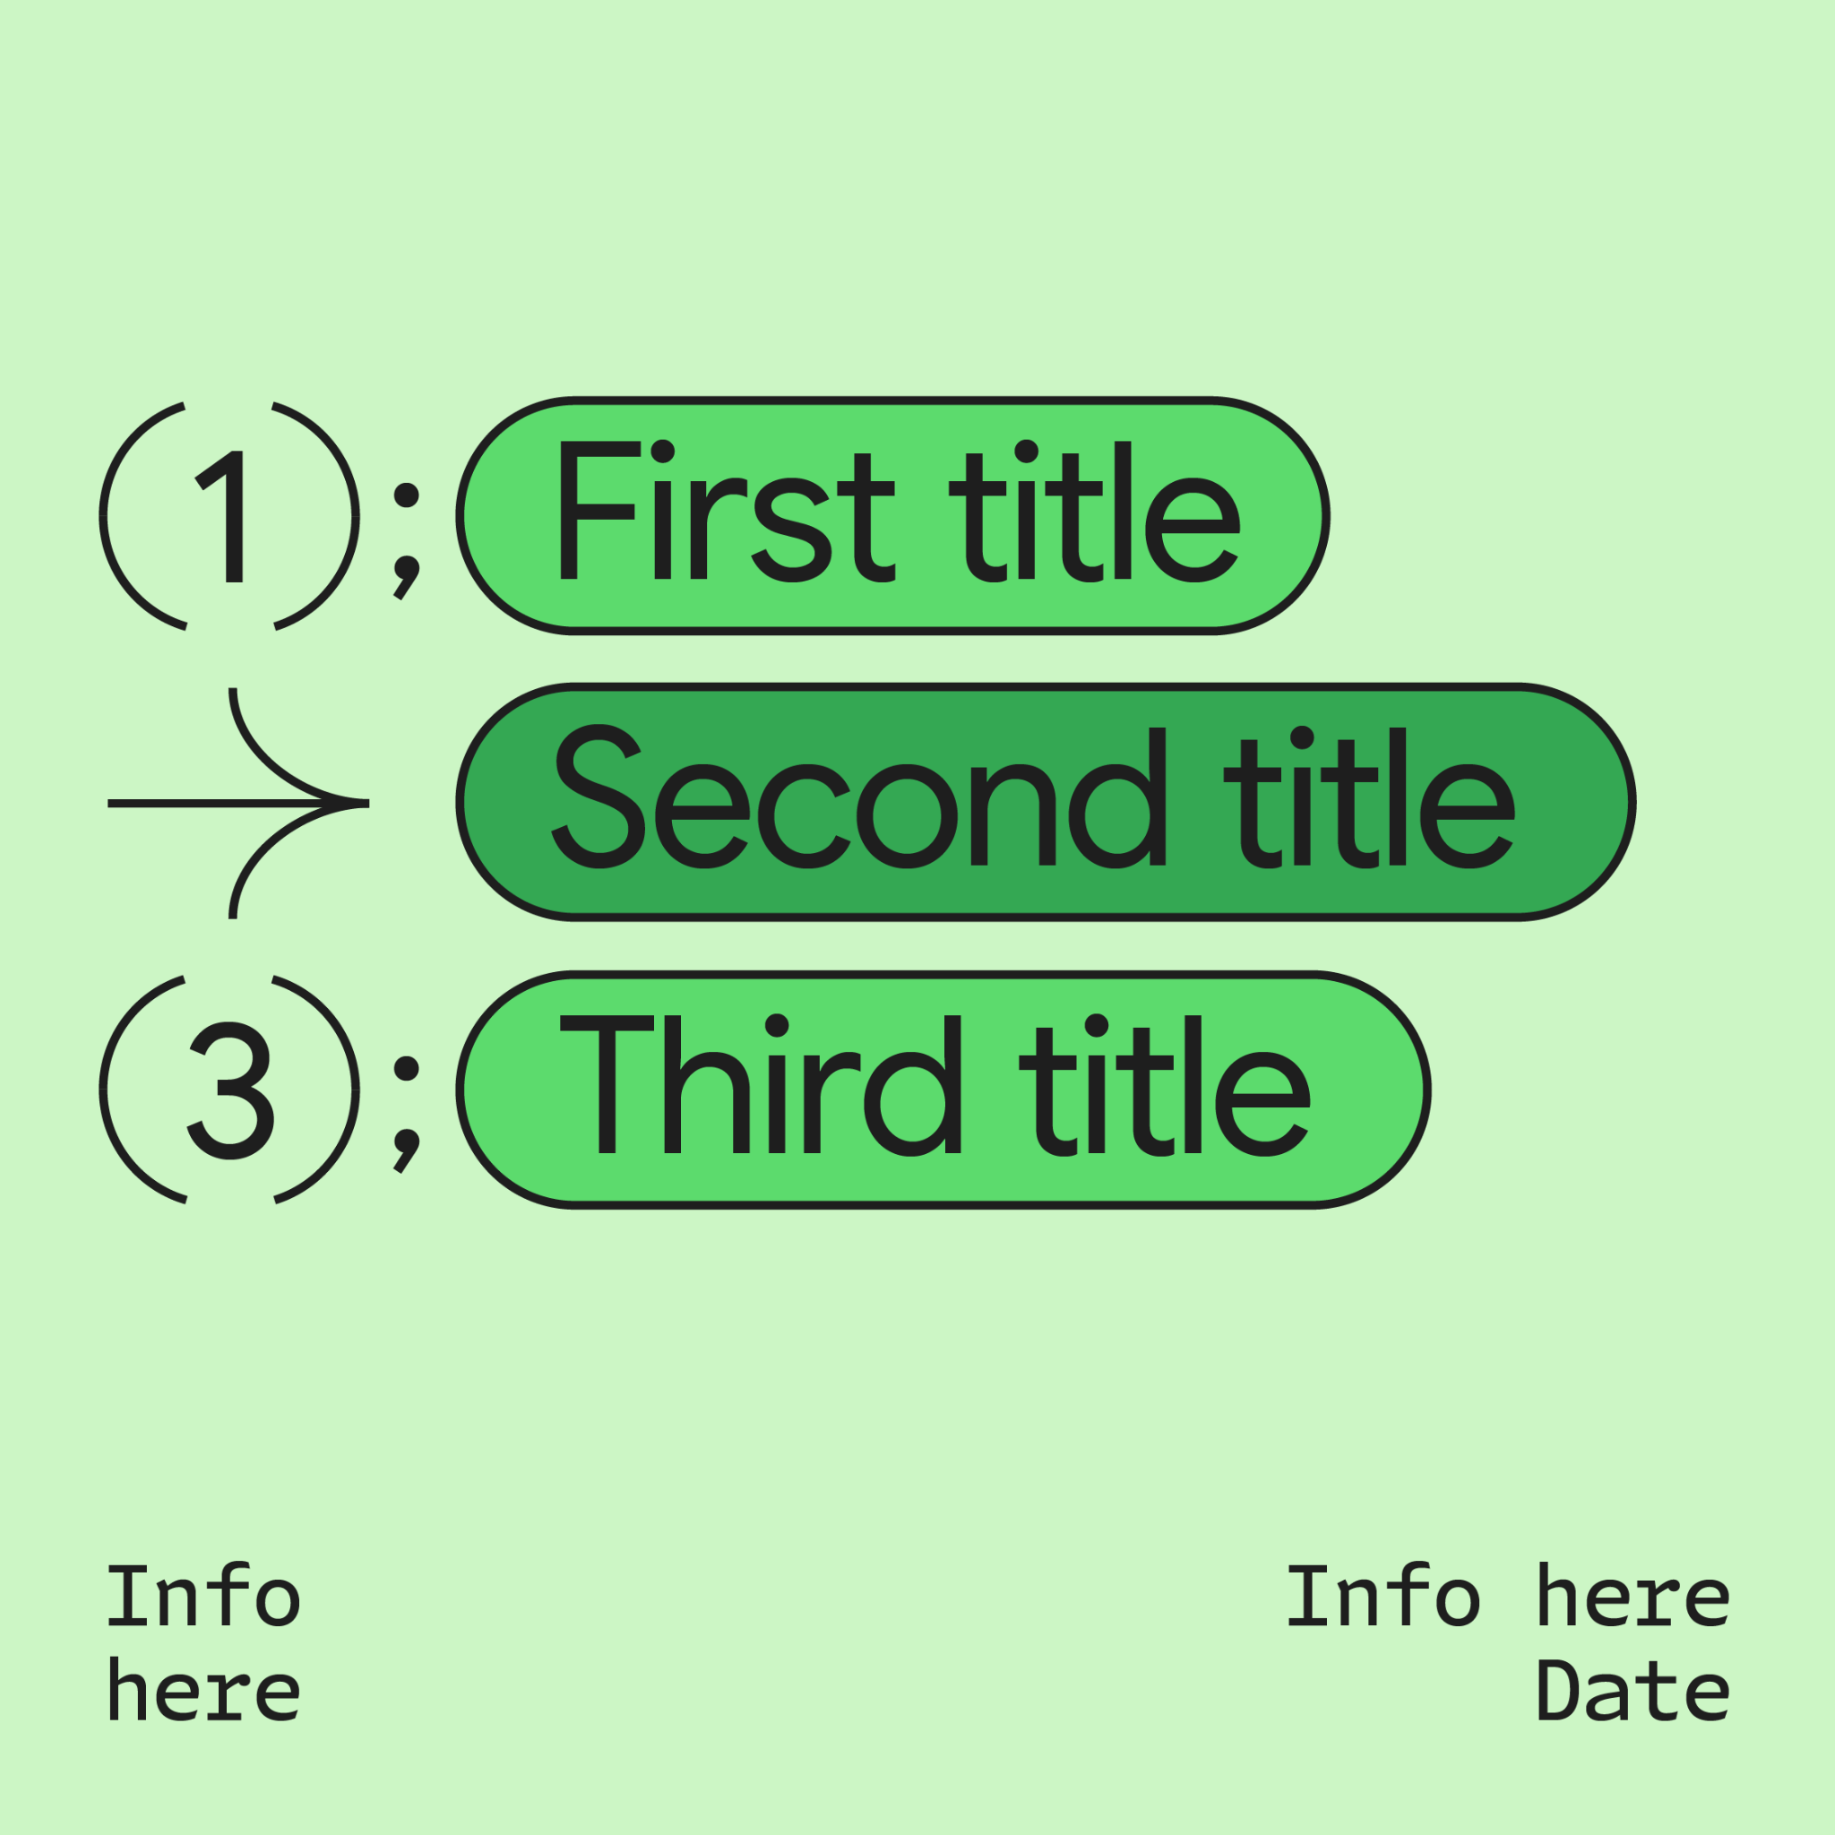



What you will get in next 17 minutes
Intro: Recommendation System
Architecture: Raw Dataset to Final Results
Code (Yes, its code!)
Tips to Scale

Slide 6

A bit about myself
Build short-videos recommendation at scale in production serving millions of users
Certified Google Cloud Professional Machine Learning Engineer (PMLE).
15 years working experience multi-domains and loves open-source ! https://github.com/yodiaditya

Slide 7
Collaborative Filtering
Content Based Filtering
Short
A
Short
B
Short
C
Short
D
Short
A
Short
B
Short
C
Short
D
Similar contents features
Similar interactions
Notes:
Content-based filtering uses item features to recommend other items similar to what the user likes, based on their previous actions or explicit feedback. Since the feature representation of the items are hand-engineered to some extent, this technique requires a lot of domain knowledge. Therefore, the model can only be as good as the hand-engineered features. The model can only make recommendations based on existing interests of the user. In other words, the model has limited ability to expand on the users' existing interests.
Collaborative filtering uses similarities between users and items simultaneously to provide recommendations.
The prediction of the model for a given (user, item) pair is the dot product of the corresponding embeddings. So, if an item is not seen during training, the system can't create an embedding for it and can't query the model with this item. This issue is often called the cold-start problem.

Slide 8

Users upload videos to server
?
Shorts Videos
(Raw version)

Slide 9

First step is to extract the information from the videos
Feature Extraction
Images
Audio

Slide 10
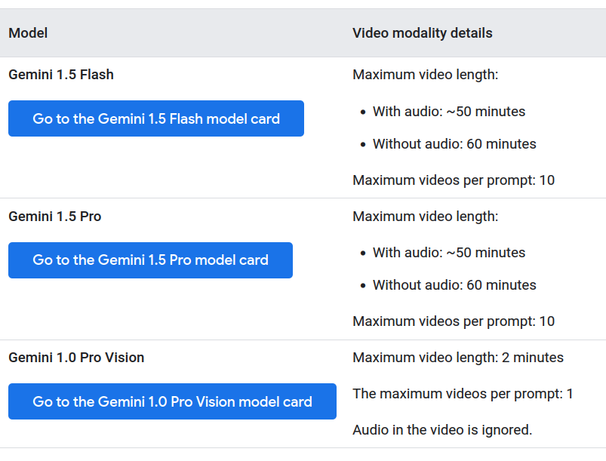


Gemini: Video Understanding
Generated
video information
https://cloud.google.com/vertex-ai/generative-ai/docs/multimodal/video-understanding

Slide 11
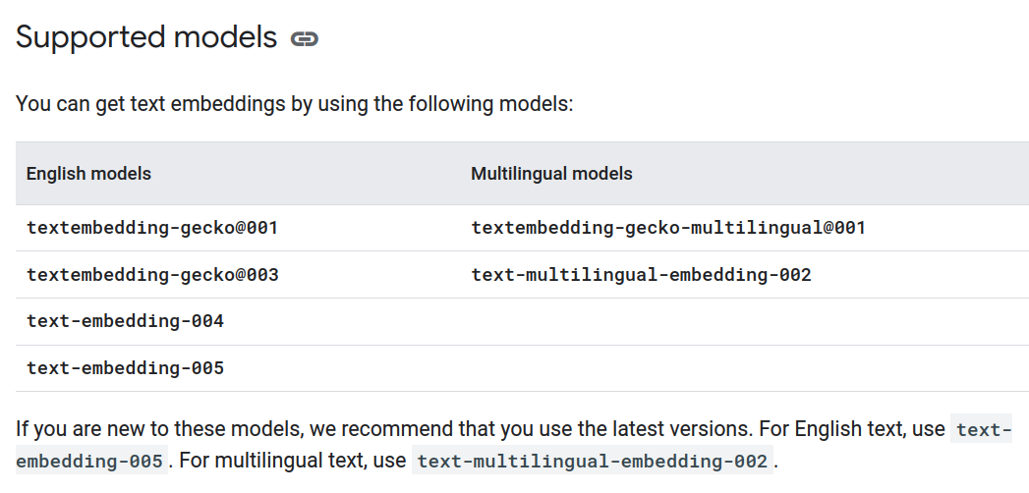
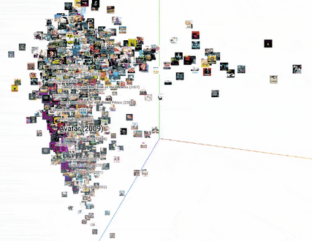
Next, Embedding Space
Generated
video information
https://cloud.google.com/vertex-ai/generative-ai/docs/embeddings/get-text-embeddings

Slide 12
Architecture Content-Based Raw Shorts Videos
Feature Extraction
Gemini
Video Understanding
Video Info
Shorts Videos
(Raw Files)
Store to DB
Convert to Embedding
API

Slide 13
Show me the code

Slide 14
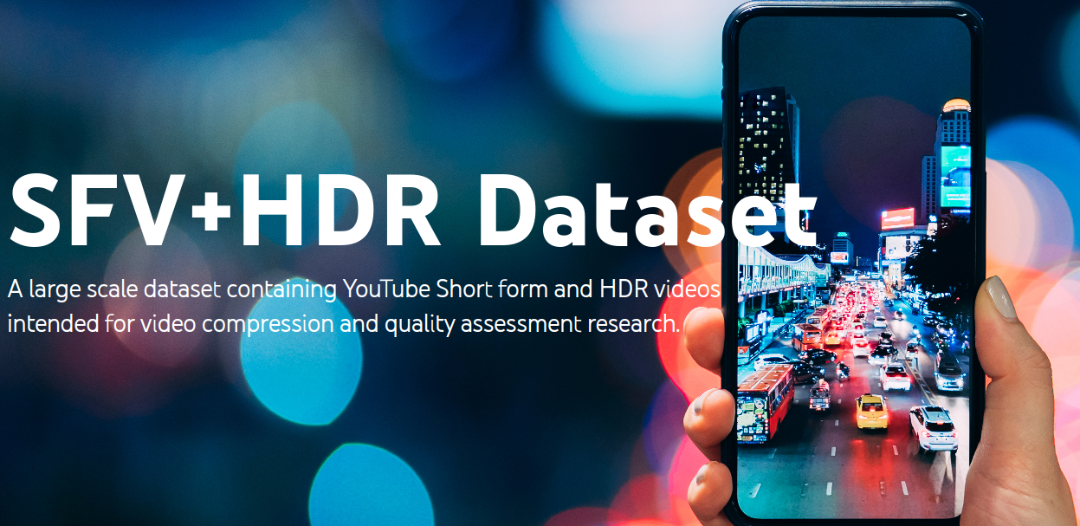
import vertexai
from vertexai.generative_models import GenerativeModel, Part
PROJECT_ID = 'YOUR-PROJECT-ID'
vertexai.init(project=PROJECT_ID, location="us-central1")
vision_model = GenerativeModel("gemini-1.5-flash-002")
# Generate text
response = vision_model.generate_content(
[
Part.from_uri(
"gs://shorts-hdr-dataset/videos/sdr/SDR_Animal_45j4.mp4", mime_type="video/mp4"
),
"Watch each frame in video. Do not make up any information that is not part of the video. Generate title of video, genres, short description and taggings of content ",
]
)
print(response.text)
https://media.withyoutube.com/sfv-hdr

Slide 15
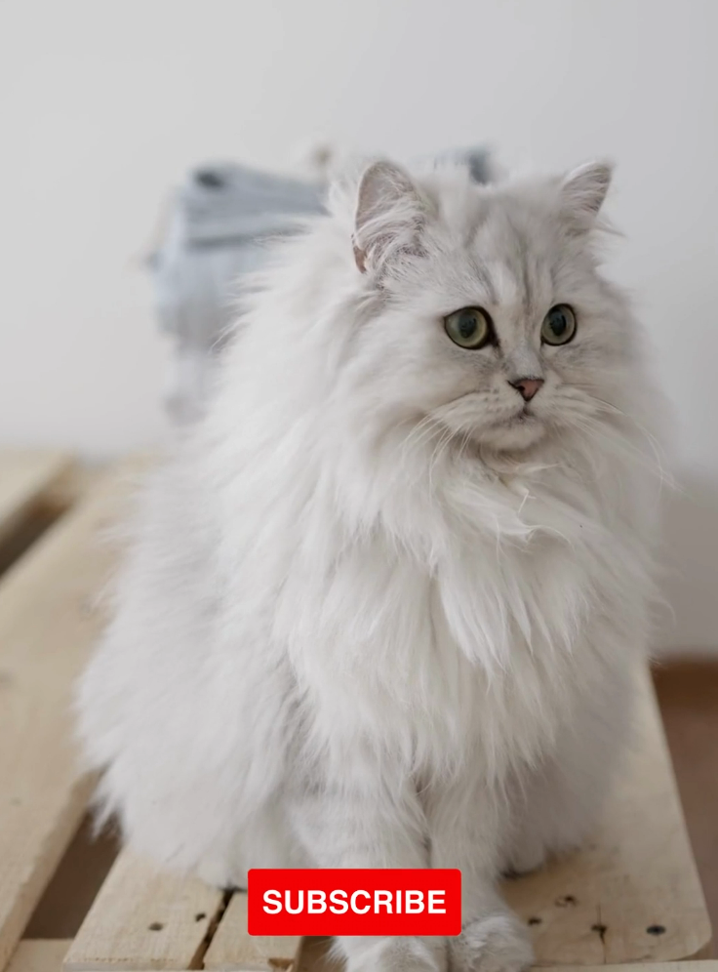
Here's a breakdown of the video based on your request: **Title:** Fluffy Persian Cat **Genres:** Animals, Cats, Pets **Short Description:** A beautiful fluffy Persian cat sits on a wooden pallet. **Taggings:** Persian cat, fluffy cat, cat, kitten, pets, animals, cute, adorable, white cat, long hair cat

Slide 16
Architecture Content-Based Raw Shorts Videos
1
2
Feature Extraction
Gemini
Video Understanding
Video Info
Shorts Videos
(Raw Files)
Store to DB
Convert to Embedding
Next
API

Slide 17
import google.generativeai as genai
import os
genai.configure(api_key=os.environ["GEMINI_API_KEY"])
text = f"""
*Title:** Fluffy Persian Cat **Genres:** Animals, Cats, Pets
**Short Description:** A beautiful fluffy Persian cat sits on a wooden pallet.
**Taggings:** Persian cat, fluffy cat, cat, kitten, pets, animals, cute, adorable, white cat, long hair cat"""
result = genai.embed_content(
model="models/text-embedding-004",
content=text)
print(str(result['embedding']))

Slide 18
[-0.07675823, 0.027660733, 0.049145754, -0.045824636, 0.061620172, 0.032313757, -0.015517017, -0.03240082, 0.015460015, 0.062071748, -0.03166332, 0.036584534, 0.024837952, 0.009332091, 0.04251558, -0.029856514, 0.05006616, 0.073106274, -0.029902106, -0.025679907, 0.084334895, -0.017889986, 0.059542187, 0.0013102485, -0.04699988, -0.007112105, 0.055407282, 0.018771457, 0.07350461, -0.01813061, 0.04455579, 0.064248785, 0.00448263, 0.008756887, 0.047846865, -0.025803361, -0.019773666, 0.041618045, 0.051186264, -0.07005315, -0.033514354, -0.026876828, -0.0008525868, 0.08978644, 0.027724743, 0.010746625, -0.061409652, 0.026029717, -0.0034387638, 0.035402797, 0.007589881, -0.023214854, -0.019220363, 0.02619021, -0.026539033, 0.012508128, 0.0040561967, -0.028133305, -0.016629174, 0.020951482, 0.06473735, 0.034282178, 0.051744517, 0.019634075, -0.016341783, 0.021416675, -0.05009744, -0.0076771406, -0.036871992, 0.095764354, -0.02469845, 0.025160229, -0.046339314, 0.024582243, -0.008852839, -0.010245625, 0.011931524, 0.037149847, -0.027476897, 0.021095295, -0.0048002778, 0.012314561, 0.09466355, -0.028999066, -0.010545491, 0.019936696, -0.0075119766, 0.02987802, -0.08925607, 0.0030204963, 0.06398722, -0.005665603, 0.055336952, 0.031011213, 0.0803204, -0.046087332, -0.09462911, -0.029559113, 0.017180113, 0.035609562, -0.041688204, 0.016256401, -0.018201571, -0.06340068, 0.05076339, 0.00789683, -0.04663778, 0.003865695, -0.02993782, 0.05526901, -0.059481055, -0.08222241, -0.044425923, 0.03254365, 0.052314047, 0.077546, 0.0024010574, 0.030455906, -0.017964754, -0.03830613, 0.042473085, 0.021389754, 0.031468235, -0.0121501945, -0.010297442, 0.012780487, -0.0086625, -0.019988453, 0.017340286, -0.009815917, 0.068223, 0.02263392, 0.02600014, 0.03895912, -0.01126567, 0.03847954, 0.035594787, -0.08233705, 0.007975588, -0.010537024, -0.042857118, -0.037623975, -0.04778282, 0.007993469, 0.0021377627, -0.046956647, -0.019428788, 0.068178736, -0.002273978, 0.032764167, 0.022261541, -0.050062243, -0.0049963817, -0.0493768, 0.027171357, 0.030386483, 0.035637327, -0.026583953, -0.05276558, -0.051282965, 0.060191035, -0.03913675, 0.009324002, -2.8839599e-05, -0.010929866, -0.0029119896, 0.013345155, -0.013394253, 0.006282062, -0.029159687, -0.023629908, -0.04224124, -0.045065757, -0.023713488, -0.038271822, 0.046776716, -0.024885133, -0.05454553, -0.07411608, 0.02653326, 0.01615619, -0.017124163, -0.03665412, -0.07935555, 0.034953605, -0.073878795, -0.035953894, -0.019765098, 0.004043873, 0.024911957, -0.005691729, -0.050333932, -0.000985027, -0.036075074, 0.011225469, -0.016764432, 0.09254729, -0.072244085, -0.037920788, 0.0124474, 0.041128416, -0.018892227, 0.02873513, 0.03394367, 0.005887189, 0.04828047, -0.015023347, -0.010894143, 0.003211685, -0.042894274, -0.110083245, 0.013853838, 0.02313884, -0.072523855, 0.024407636, 0.02207754, 0.027719164, -0.01624695, 0.040581483, -0.039446704, 0.062565975, 0.014453987, 0.021910533, -0.019675337, 0.04837492, -0.011042686, -0.02570678, -0.0035492862, -0.012308466, -0.020631982, -0.035574436, 0.042452924, 0.022002371, -0.012221022, -0.039625946, 0.009512582, 0.0071309633, -0.01212419, -0.014330538, 0.06173416, -0.007517297, 0.016374068, 0.08243889, 0.0066845445, 0.053010326, 0.004689015, 0.027499422, 0.05117024, -0.06105194, -0.0407715, -0.006838235, 0.007643424, -0.028924558, 0.031687874, -0.06336678, -0.01165728, -0.003804315, 0.04765609, -0.008533617, 0.006844215, -0.026217818, -0.049941003, -0.010676516, -0.039658975, ….

Slide 19
Tips to scale

Slide 20
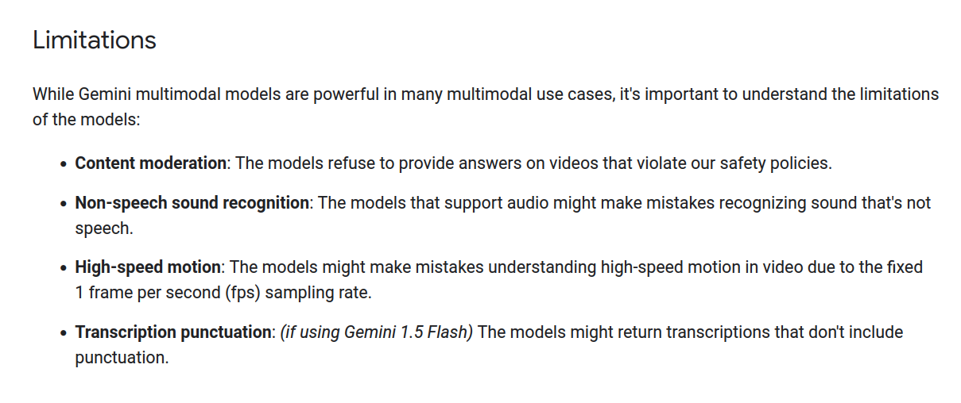
Gemini: Video Understanding
https://cloud.google.com/vertex-ai/generative-ai/docs/multimodal/video-understanding

Slide 21
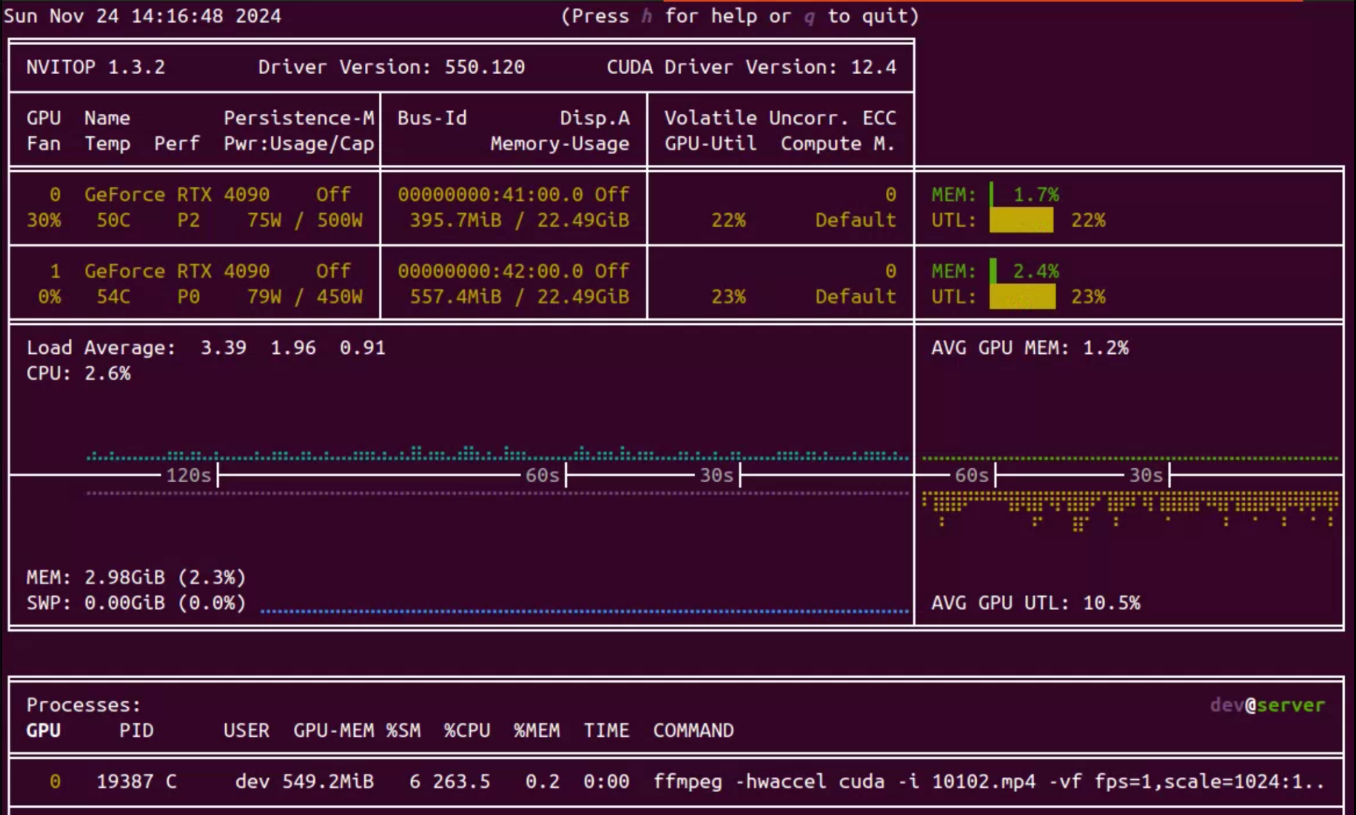
#!/bin/bash
# Create the output folder if it doesn't exist
mkdir -p small
files=(*.mp4)
for i in "${!files[@]}"; do
file="${files[$i]}"
filename=$(basename "$file" .mp4)
output="small/${filename}.mp4"
gpu=$((i % 2))
CUDA_VISIBLE_DEVICES="$gpu" ffmpeg -hwaccel cuda -i "$file" -vf "fps=1,scale=1024:1024:force_original_aspect_ratio=decrease,pad=1024:1024:(ow-iw)/2:(oh-ih)/2" \
-c:v h264_nvenc -preset slow -cq 30 -c:a aac -b:a 96k -movflags +faststart "$output" &
echo "Started processing: $file on GPU $gpu"
# Wait for processes to complete every two files
if ((i % 2 == 1)); then
wait
fi
done
Use FFMPEG-GPU NVIDIA
Reduce size and apply FPS 1
Process 2,6K videos: 31GB to 2.7GB (90% reduction) with FPS 1. 10x faster speed than CPU.

Slide 22
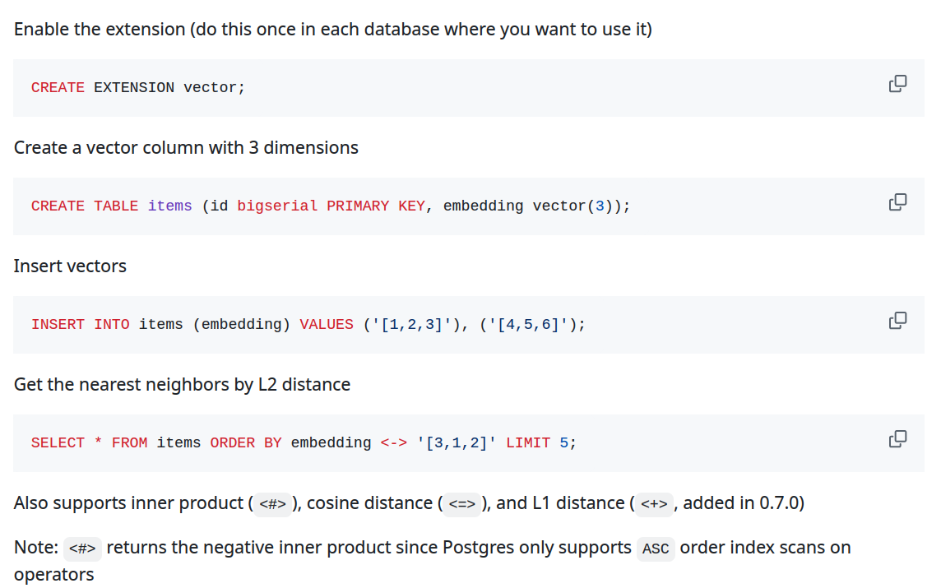
Use PostgreSQL and PGVector
https://github.com/pgvector/pgvector

Slide 23

Thank you!
Linkedin
linkedin.com/in/yodiaditya
Github
https://github.com/yodiaditya

